Slide 1
U-3
Model free learning

Slide 2
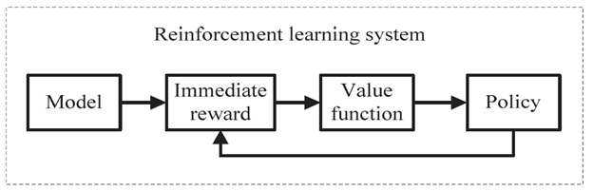
There are 2 main types of RL algorithms. They are model-based and model-free.
A model-free algorithm is an algorithm that estimates the optimal policy without using or estimating the dynamics (transition and reward functions) of the environment.(cram all the things of algo) Whereas, a model-based( for fixed environment problems)
algorithm is an algorithm that uses the transition function (and the reward function) in order to estimate the optimal policy.(understand the underlying principles of algorithm)

Slide 3
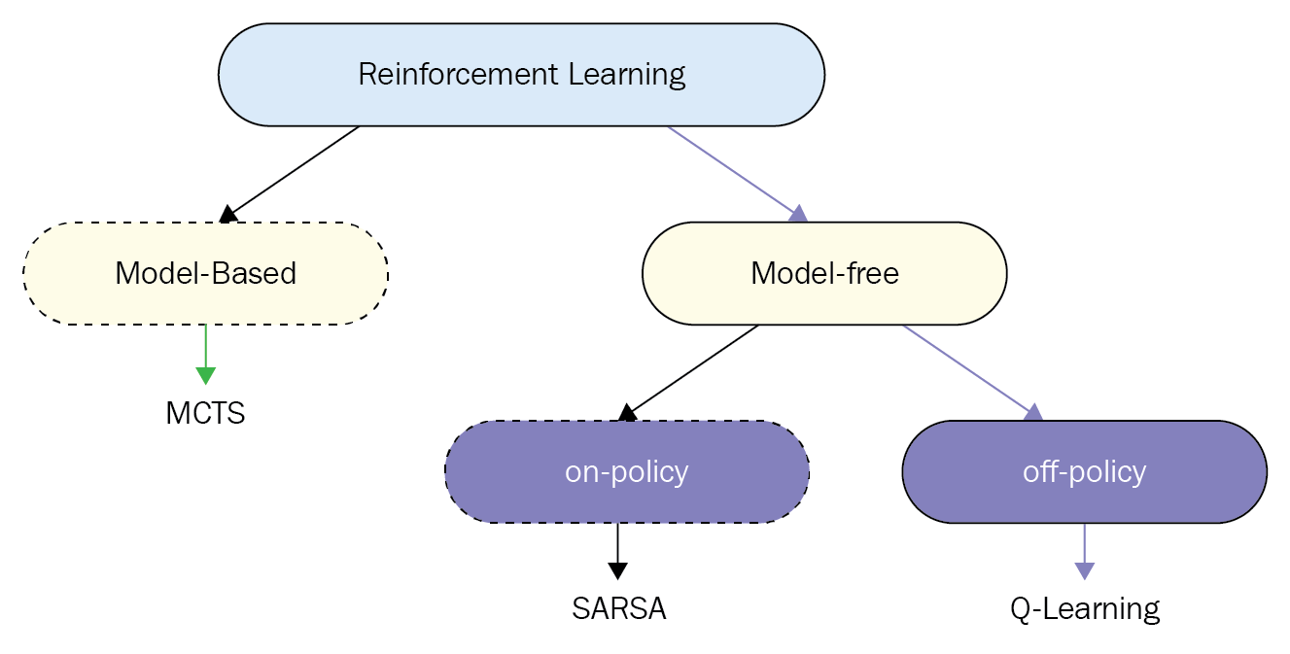
MCTS-Monte Carlo Tree Search

Slide 4
On-Policy vs Off-Policy (With Real-Life Examples)
In reinforcement learning, the key difference is:
On-policy → Learn about the policy you are actually following
Off-policy → Learn about a different (usually better) policy than the one you are following
1. On-Policy Learning (Learn What You Do)
You learn from the exact actions you take — including exploration and mistakes.
Real-Life Example: Learning to Drive Carefully
Imagine you're learning to drive on mountain roads.
You decide:
“I’ll sometimes try slightly risky turns to learn.”
Every time you:
Take a turn
Feel how risky it was
Adjust your future behavior
You're learning based on the actual actions you took, even if they were imperfect.
That’s on-policy learning.
RL Example: SARSA
With SARSA, the update uses the next action that your current policy actually selects.
So if you’re using ε-greedy (sometimes exploring), your learning reflects that exploration.

Slide 5
2. Off-Policy Learning (Learn From Someone Else / Ideal Behavior)
You behave one way but learn as if you behaved optimally.
Real-Life Example: Watching an Expert Chef
You:
Cook food yourself (maybe making mistakes)
But you study videos of a professional chef
You adjust your knowledge based on how the expert does it
You're acting one way, but learning from a different policy (the expert's).
That’s off-policy learning.
RL Example: Q-Learning
Q-learning:
May explore randomly
But updates assuming the best possible action was taken next
It learns the optimal policy even while behaving imperfectly.

Slide 6
Feature | On-Policy | Off-Policy
Learns from | Actions actually taken | Best/other actions
Exploration affects learning? | Yes | No (learns optimal anyway)
Example Algorithm | SARSA | Q-learning
Risk behavior | Safer | More aggressive
On-policy = “I learn from what I do.”
Off-policy = “I learn from what I should have done.”

Slide 7
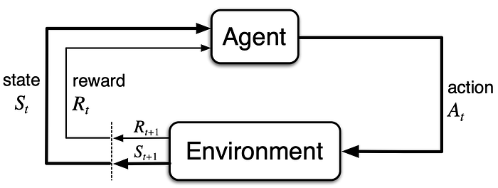
Problem Statement: You just moved to a new locality and have tried a few restaurants in your area. Today you are going out to eat again at a restaurant.
We are transforming the problem of selecting the best restaurant to eat at into Reinforcement learning.
You, the Agent, or the decision maker, are constantly trying to find the best restaurant experience in your area, referred to as an Environment, taking action by visiting restaurants at different time steps. Based on what restaurant you visit, the Environment or the restaurant changes the state, which is the restaurant experience. As a result, you receive a numerical reward from the Environment regarding a good or bad experience.
The sole objective of the Agent, which is you, is to maximize the total reward to get the best restaurant experience in your area over the long run.

Slide 8
A policy is a strategy an agent deploys in pursuit of a goal.
The Policy dictates an agent's actions in an environment to maximize its long-term reward.
A policy is optimal if its expected reward is greater than or equal to any other policy for all states.
In the case of finding the best restaurant experience in your area, the actions you take generate your Policy or strategy.
Agent’s policy changes due to its experience while exploring and exploiting the Environment.
You can decide to go to your favorite restaurant based on your experience or try a new restaurant. When you choose your favorite restaurant based on history, you have exploited the best available information. In contrast, when you try to be adventurous to try a new restaurant and gather more information, you are exploring new restaurants that may turn out to be the best restaurant you have ever been to in the area or maybe an average restaurant.

Slide 9
You face a dilemma of exploiting the already known information, which, in this case, is already known restaurants, or exploring new restaurant options; this is known as the Exploration-Exploitation dilemma.
Exploration is when the Agent tries to improve its knowledge about each action it can take that would lead to long-term benefits.
Exploitation is when the Agent exploits the current knowledge by being greedy to choose the greedy approach to get the most reward.
An Agent in Reinforcement learning needs to find a balance between exploration, attempting to discover new states about the Environment by a selecting sub-optimal actions
and exploitation, or using what the Agent already knows about the Environment to get the best results is Exploration-Exploitation trade-off.

Slide 10
During exploration, the reward is lower in the short run and higher in the long run. After discovering better actions, you can exploit them many times.
It is impossible to explore and exploit with any single action selection. Thus the dilemma is that neither exploration nor exploitation can be applied exclusively. To understand the Environment and maximize the long-term reward, the Agent must try a variety of actions and progressively favor those that appear to be best.
When the Agent becomes greedy, then it exploits the current knowledge by selecting an action based on the actions with the highest known value, and such a policy is called a greedy policy.
ε(epsilon)-Greedy is a simple method to balance exploration and exploitation by choosing between exploration and exploitation randomly. ε- Greedy policy takes an exploratory action with probability ϵ and a greedy action with probability 1−ϵ with a desire to explore the Environments entire state space to seek an optimal policy.

Slide 11
On-policy methods attempt to evaluate or improve the same Policy that is used to make decisions.
The On-Policy can be understood as when trying different restaurants in your area to search for the best restaurant. Hence, you are the one to evaluate the decision as well as improve the decision.
The off-policy method uses a behavioral policy to explore the environment and to collect samples generating Agent’s behavior and a second policy being learned called the target policy which is optimized.
Behavior Policy is the policy Agent uses to determine its action in a given state, so behavior policy is in charge of selecting actions for the Agent.
Target Policy is the policy Agent uses to learn from the rewards received for its actions which are used to update the Q-value.
Actions selected by the target policy should be selected at least from time to time by the behavior policy if the target policy decides that the action should be executed.

Slide 12
When the target policy is different from the behavior policy, then the agent is called an off-policy learner.
when the target policy is the same as the behavior policy, then the agent is called an on-policy learner.
The Off-Policy can be understood as when you use Google to recommend the best restaurants, but you decide if you want to follow Google's recommendations to search for the best restaurant in your area or not. Here Google recommendations can be thought of as a behavioral policy, and when you decide, you act like a target policy.

Slide 13
Moving in to Q-Learning(Q means quality)
Q-learning is a model-free reinforcement learning algorithm.
Q-learning is a values-based learning algorithm. Value based algorithms updates the value function based on an equation(particularly Bellman equation). Whereas the other type, policy-based estimates the value function with a greedy policy obtained from the last policy improvement.
Q-learning is an off-policy learner. Means it learns the value of the optimal policy independently of the agent’s actions. On the other hand, an on-policy learner learns the value of the policy being carried out by the agent, including the exploration steps and it will find a policy that is optimal, taking into account the exploration inherent in the policy.

Slide 14
Q-learning is a model-free, value-based, off-policy learning algorithm.
Model-free: The algorithm that estimates its optimal policy without the need for any transition or reward functions from the environment.
Value-based: Q learning updates its value functions based on equations, (say Bellman equation) rather than estimating the value function with a greedy policy.
Off-policy: The function learns from its own actions and doesn’t depend on the current policy.

Slide 15
What’s this ‘Q’?
The ‘Q’ in Q-learning stands for quality. Quality here represents how useful a given action is in gaining some future reward.
Q-learning Definition
Q*(s,a) is the expected value (cumulative discounted reward) of doing a in state s and then following the optimal policy.
Q-learning uses Temporal Differences(TD) to estimate the value of Q*(s,a). Temporal difference is an agent learning from an environment through episodes with no prior knowledge of the environment.
The agent maintains a table of Q[S, A], where S is the set of states and A is the set of actions.
Q[s, a] represents its current estimate of Q*(s,a).

Slide 16
Q-learning Simple Example
In this section Q-learning has been explained along with a demo.
Let’s say an agent has to move from a starting point to an ending point along a path that has obstacles. Agent needs to reach the target in the shortest path possible without hitting in the obstacles and he needs to follow the boundary covered by the obstacles. For our convenience, I have introduced this in a customized grid environment as follows.
2 Things: Q-function and Q-Table

Slide 17
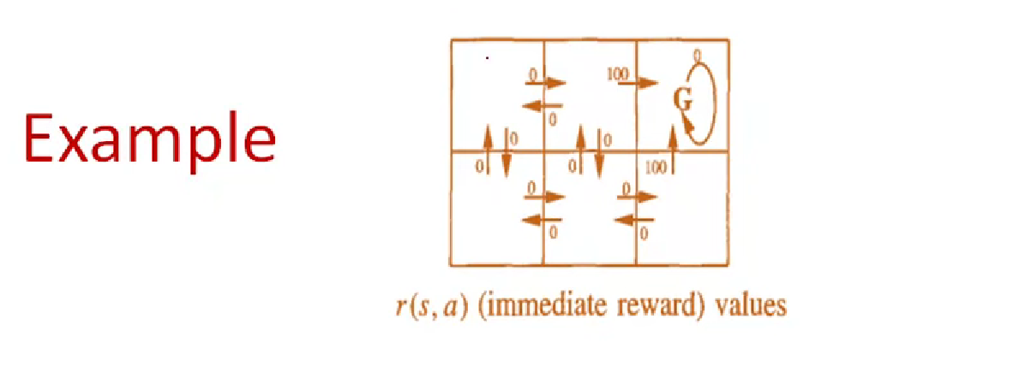

Slide 18
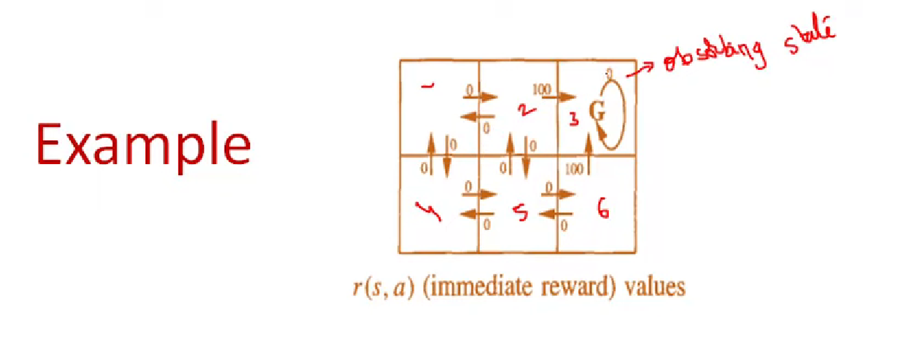

Slide 19
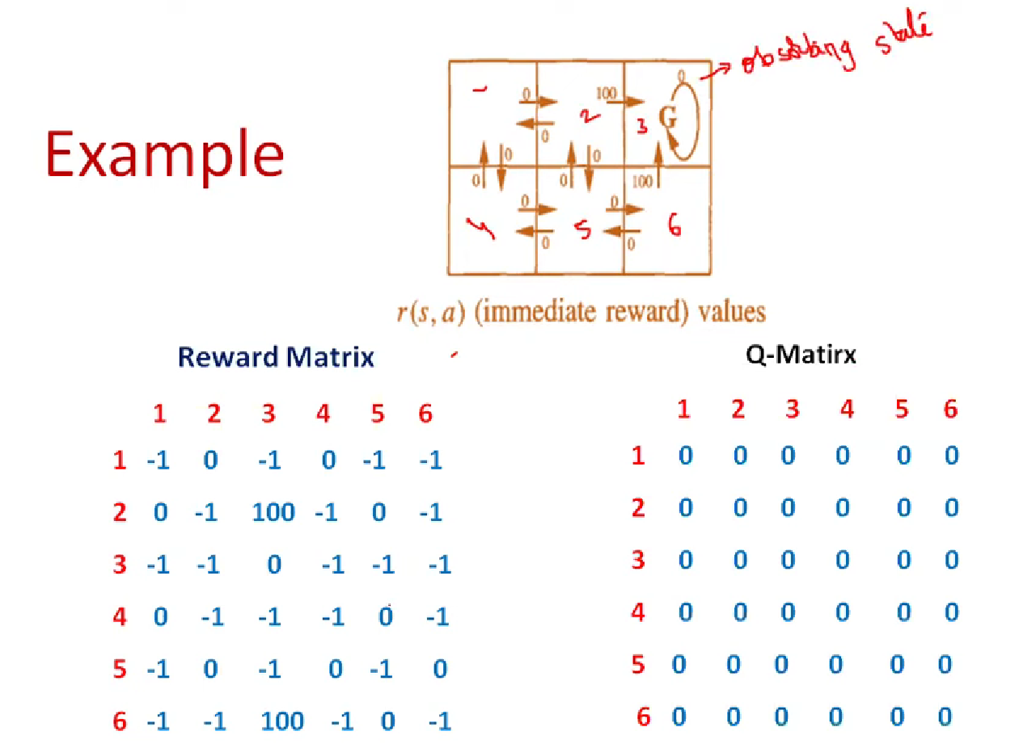

Slide 20
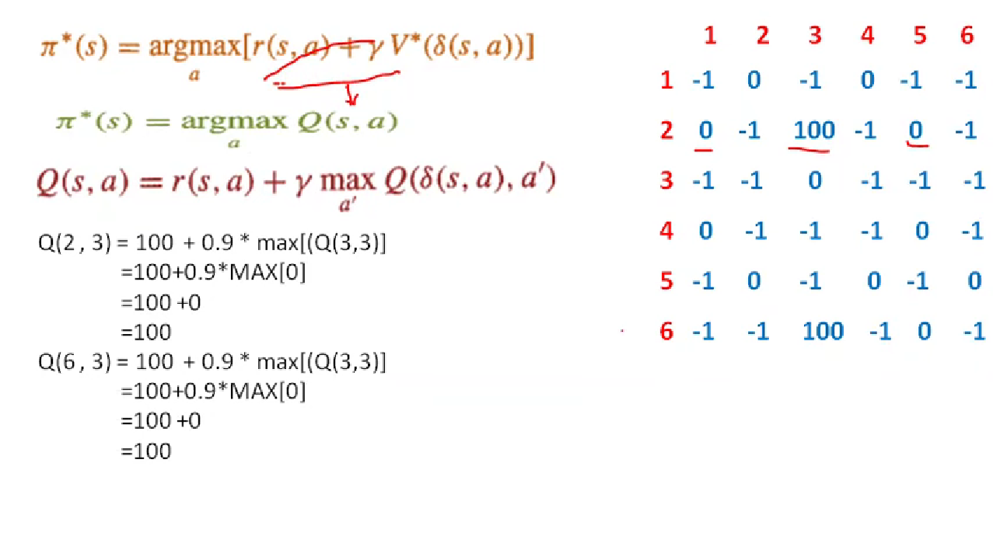

Slide 21
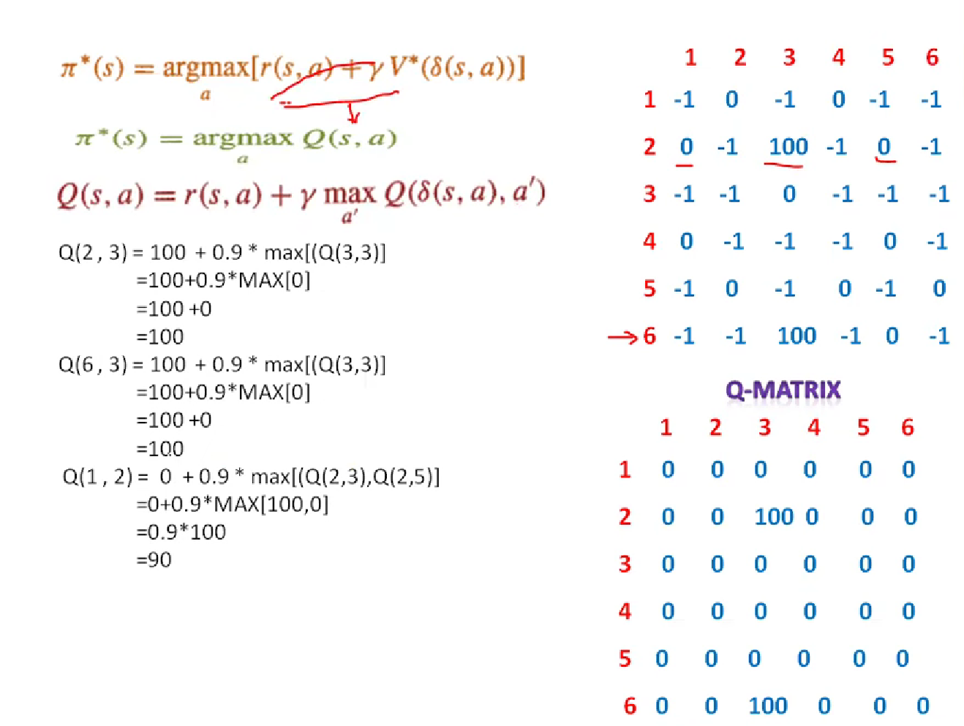

Slide 22
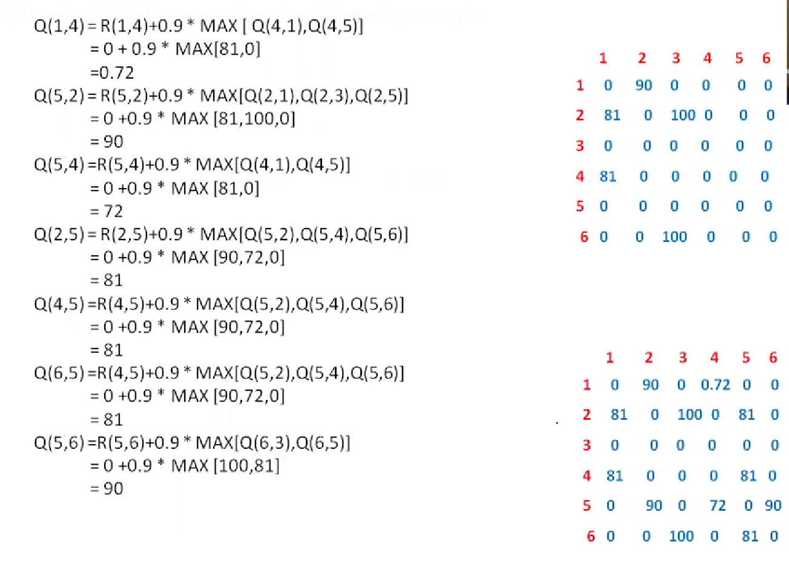

Slide 23
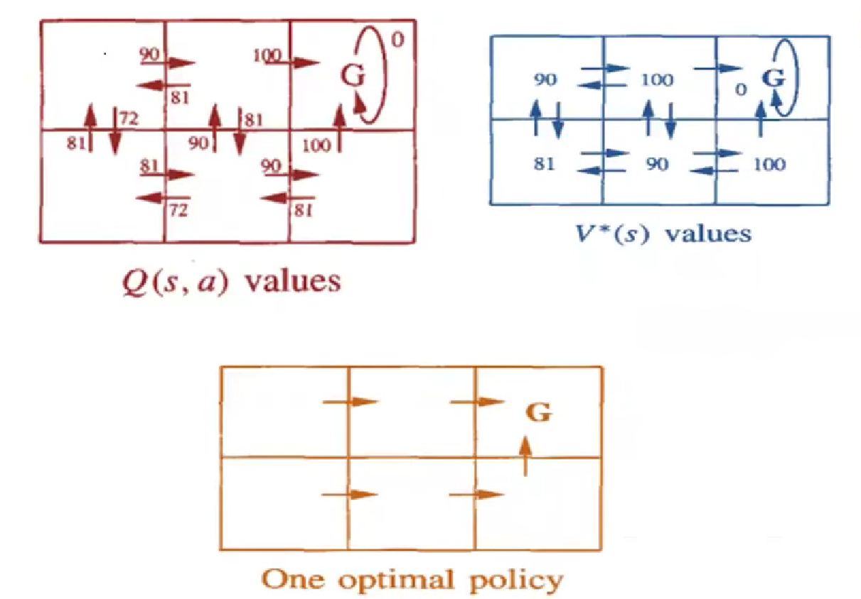

Slide 24
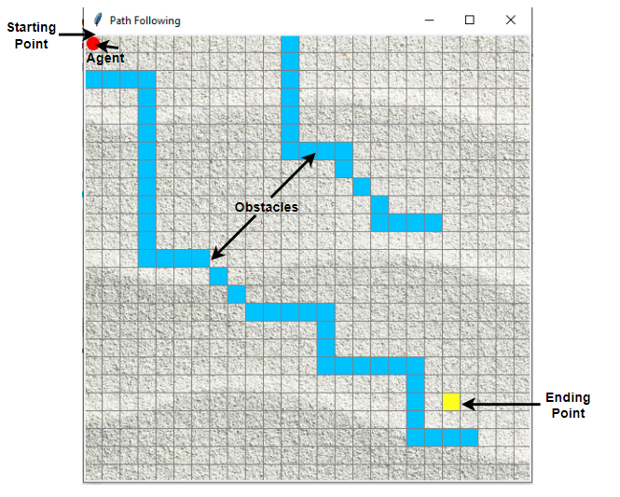

Slide 25
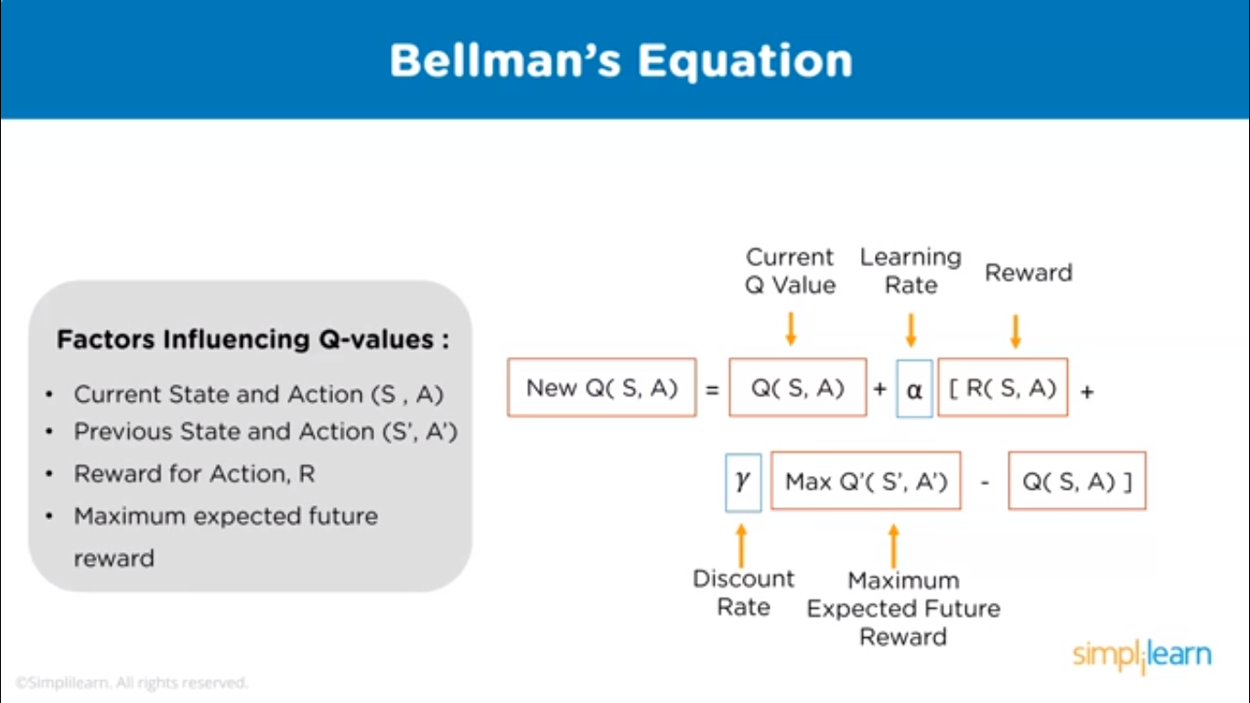

Slide 26
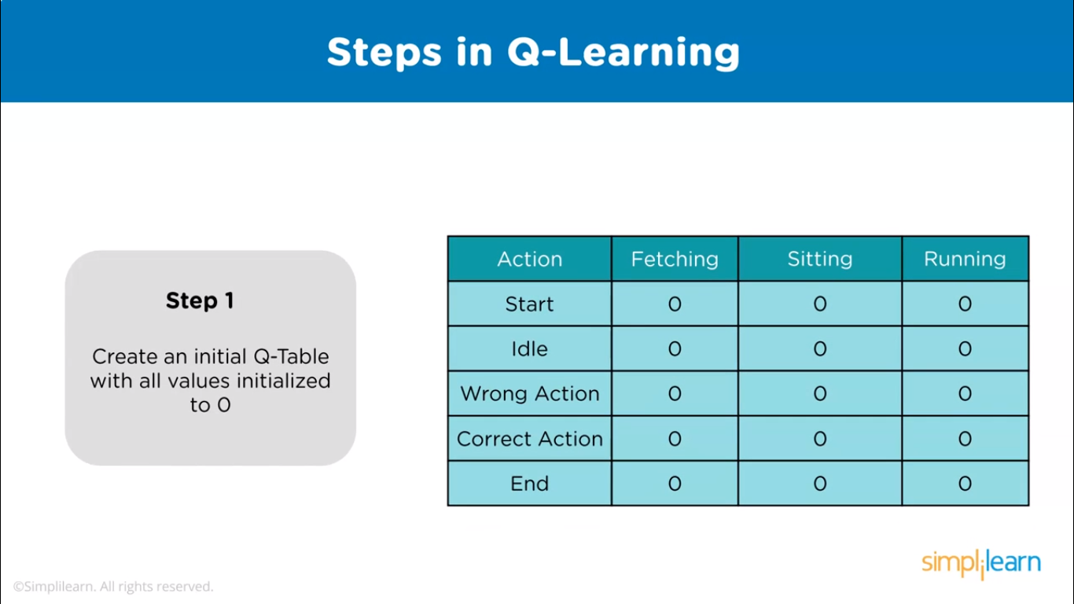

Slide 27


Slide 28
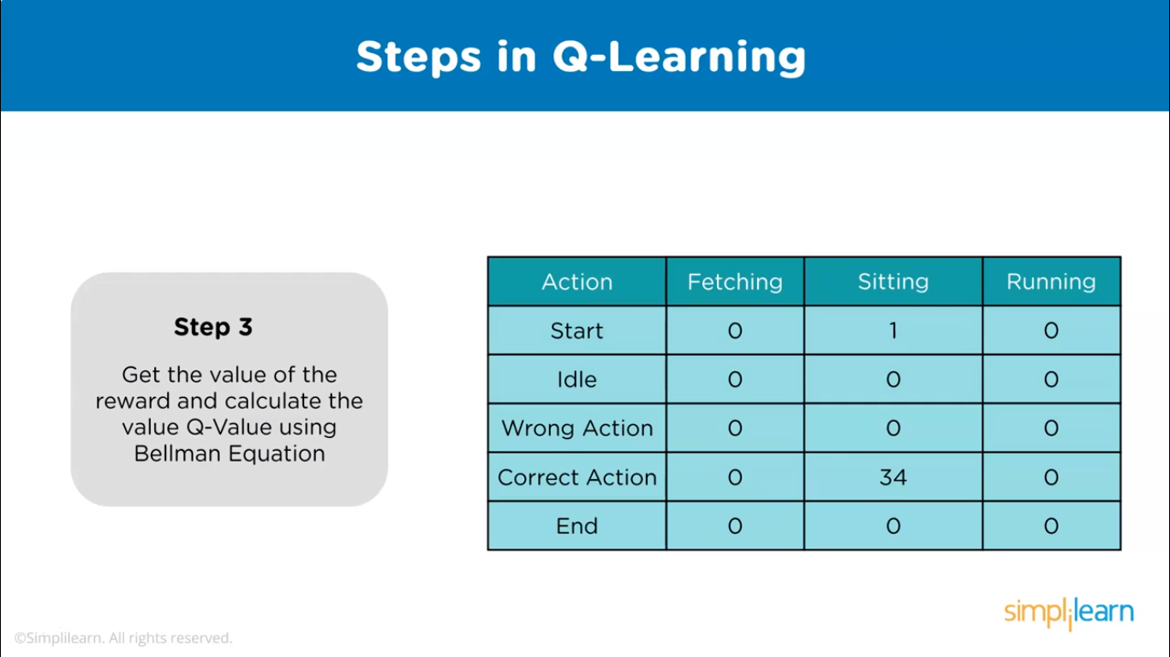

Slide 29
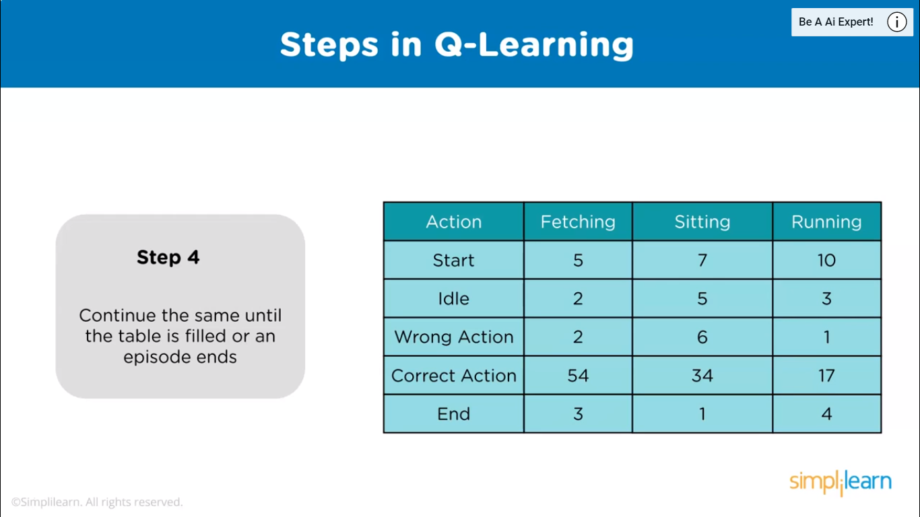

Slide 30
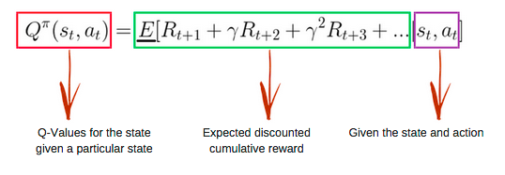
Introducing the Q-Table
Q-Table is the data structure used to calculate the maximum expected future rewards for action at each state. Basically, this table will guide us to the best action at each state. To learn each value of the Q-table, Q-Learning algorithm is used.
Q-function
The Q-function uses the Bellman equation and takes two inputs: state (s) and action (a).

Slide 31
Exploitation in Reinforcement Learning
Exploitation is defined as a greedy approach in which agents try to get more rewards by using estimated value but not the actual value. So, in this technique, agents make the best decision based on current information.
Exploration in Reinforcement Learning
Unlike exploitation, in exploration techniques, agents primarily focus on improving their knowledge about each action instead of getting more rewards so that they can get long-term benefits. So, in this technique, agents work on gathering more information to make the best overall decision.
Let's say we have a scenario of online restaurant selection for food orders, where you have two options to select the restaurant. In the first option, you can choose your favorite restaurant from where you ordered food in the past; this is called exploitation because here, you only know information about a specific restaurant. And for other options, you can try a new restaurant to explore new varieties and tastes of food, and it is called exploration. However, food quality might be better in the first option, but it is also possible that it is more delicious in another restaurant.

Slide 32

In order to overcome the Exploration-Exploitation Dilemma, we use the Epsilon Greedy Policy.
EPSILON GREEDY POLICY
To choose between exploration and exploitation a very simple method is to choose randomly. This could be one by choosing to exploit most of the time with little exploring.
Example 1
Suppose we are rolling a dice, and if it lands on 1 then we will explore, else exploit.
This method is called the Epsilon Greedy Action where Epsilon refers to the probability of choosing to explore.
In the above case the value of Epsilon will be 1/6 which is the probability of getting 1 on rolling a dice.

Slide 33
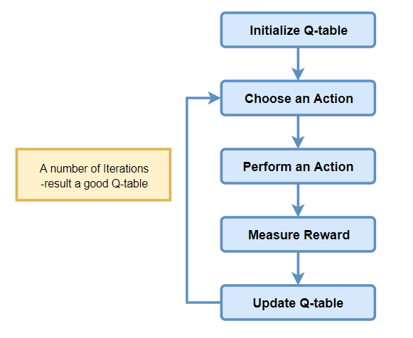
Q-learning Algorithm Process

Slide 34
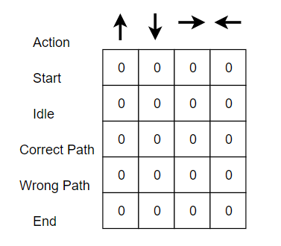
Step 1: Initialize the Q-Table(combination of actions and states)
First the Q-table has to be built. There are n columns, where n= number of actions. There are m rows, where m= number of states.
In our example n=Go Left, Go Right, Go Up and Go Down and m= Start, Idle, Correct Path, Wrong Path and End. First, let’s initialize the values at 0.

Slide 35
Step 2 : Choose an Action
Step 3 : Perform an Action
The combination of steps 2 and 3 is performed for an undefined amount of time. These steps runs until the time training is stopped, or when the training loop stopped as defined in the code.
First, an action (a) in the state (s) is chosen based on the Q-Table. Note that, as mentioned earlier, when the episode initially starts, every Q-value should be 0.
Then, update the Q-values for being at the start and moving right using the Bellman equation which is stated above.
Epsilon greedy strategy concept comes in to play here. In the beginning, the epsilon rates will be higher. The agent will explore the environment and randomly choose actions. This occurs like this logically,since the agent does not know anything about the environment. As the agent explores the environment, the epsilon rate decreases and the agent starts to exploit the environment.
During the process of exploration, the agent progressively becomes more confident in estimating the Q-values.
In our Agent example, when the training of agent starting, the agent is completely unaware about the environment. So let’s say it takes a random action to its ‘right’ direction.

Slide 36
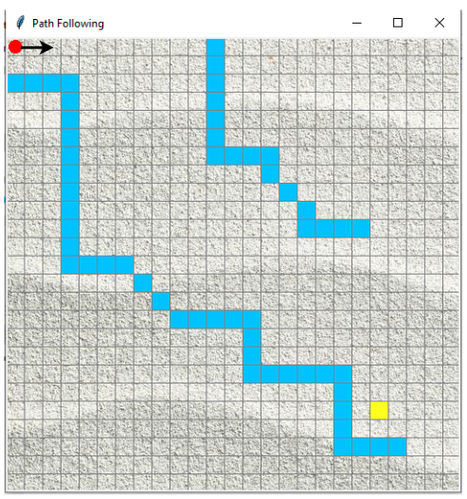

Slide 37
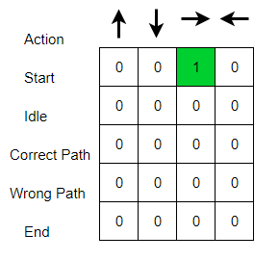
We can now update the Q-values for being at the start and moving right using the Bellman equation.

Slide 38
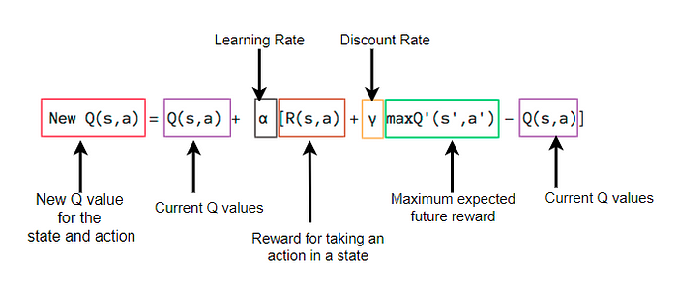
Steps 4 : Measure Reward
Now we have taken an action and observed an outcome and reward.
Steps 5 : Evaluate
We need to update the function Q(s,a).
This process is repeated again and again until the learning is stopped. In this way the Q-Table is been updated and the value function Q is maximized. Here the Q(state, action) returns the expected future reward of that action at that state.

Slide 39
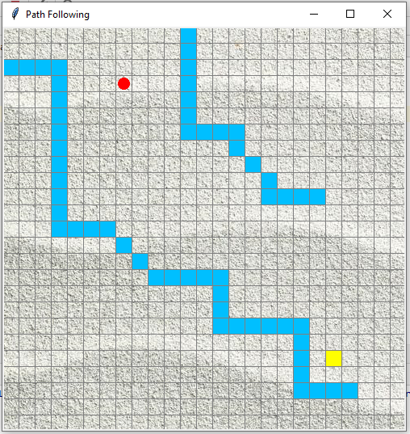
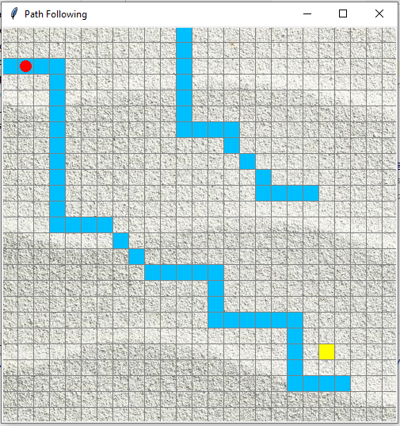
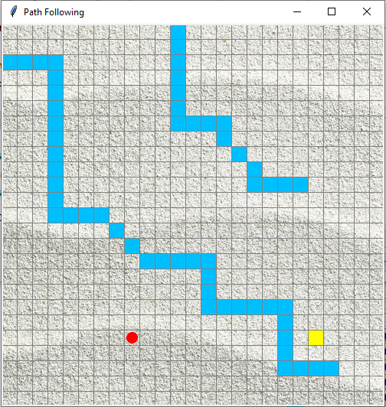
In the example, I have entered the rewarding scheme as follows.
Reward when reach step closer to goal= +1
Reward when hit obstacle =-1
Reward when idle=0

Slide 40
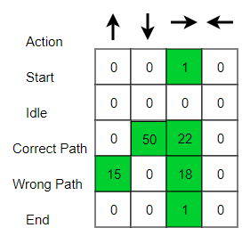
Initially, we explore the agent’s environment and update the Q-Table. When the Q-Table is ready, the agent start to exploit the environment and start taking better actions. Final Q-table can be like following (for example).
Following are the outcomes that results the agent’s shortest path towards goal after training.

Slide 41
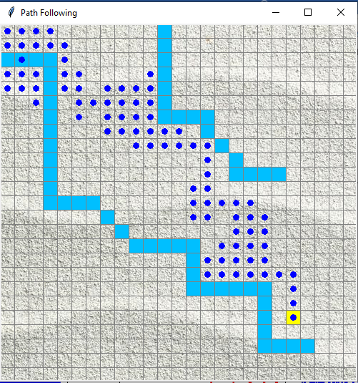

Slide 42
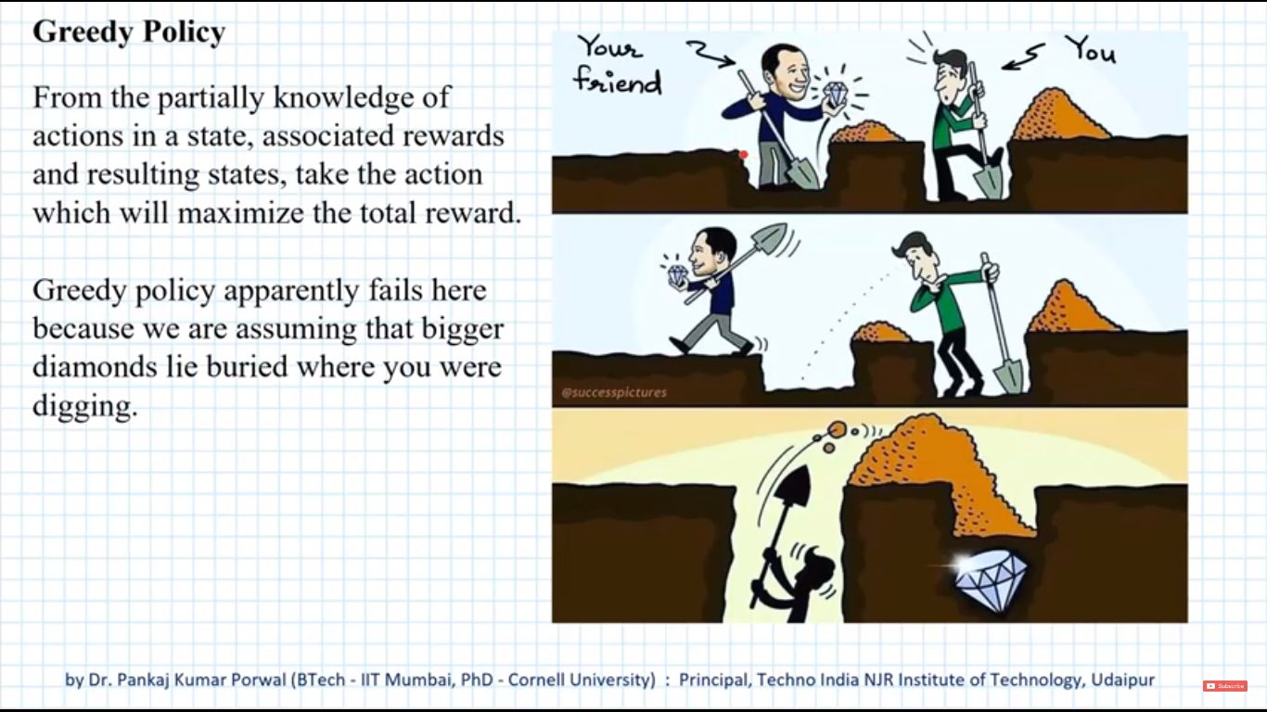

Slide 43
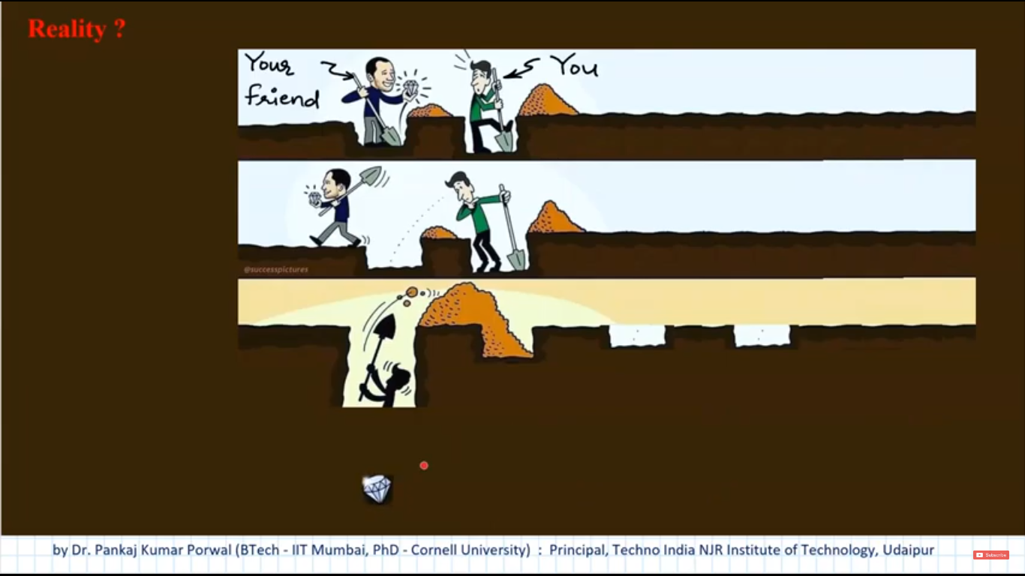

Slide 44
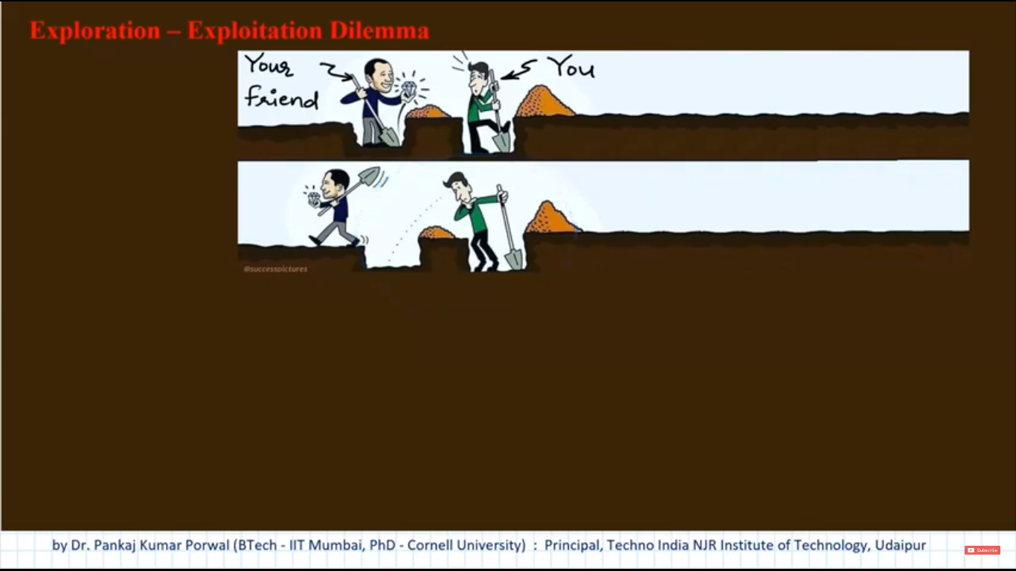

Slide 45
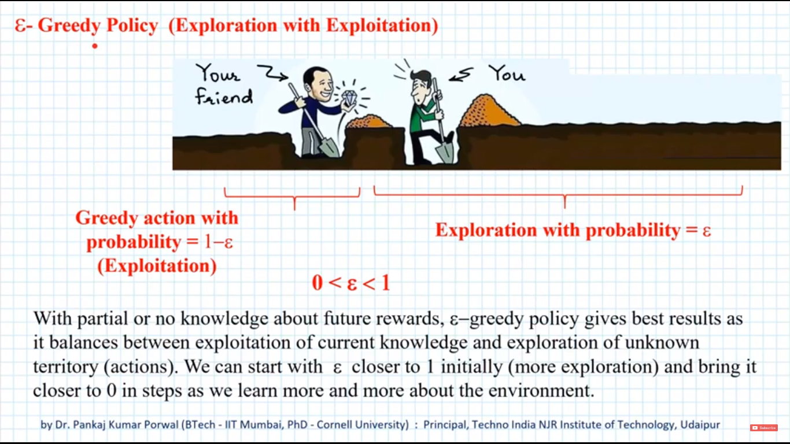

Slide 46
